Slide 1
Review 1.3
B.Tech Project (19ECE495)
Batch ID: 041
Multi-Class Classification and Detection of Knee Osteoarthritis From X- rays
MENTOR: Dr. Devi Vijayan
Dept. of Elec. and Commn. Engg.
Amrita School of Engineering, Coimbatore
CB.EN.U4ECE21008 | - | C RISHI VARDHAN REDDY
CB.EN.U4ECE21011 | - | D M SHAAHID
CB.EN.U4ECE21012 | - | DULAM SANTHOSH
CB.EN.U4ECE21033 | - | NUKALA SUMANTH

Slide 2
Introduction:
Knee osteoarthritis (KOA) is a common joint disorder characterized by the gradual degeneration of cartilage and underlying bone in the knee joint, leading to pain, stiffness, and reduced mobility.
KOA affects approximately 1 in 5 individuals in the general population and 1 in 3 people over the age of 50 [1], making it a significant contributor to impaired quality of life and daily functioning.
Early detection and accurate classification of KOA severity are critical for effective treatment, as timely interventions can prevent further joint damage and improve patient outcomes.
Current diagnostic methods, such as physical exams and X-ray imaging, are often subjective and may misclassify early stages of KOA, leading to delayed or inappropriate treatment.

Slide 3
Objective:
To build the deep-learning model for detection and classification of Knee Osteoarthritis.
Employ deep learning model to automatically categorize the severity of knee osteoarthritis into five grades (G-0 to G-4) based on the Kellgren and Lawrence classification system.
Validate and compare the deep learning model's performance against state-of-the-art models.

Slide 4
Data Preparation:
Dataset[2]:
The dataset used in the study is based on the Osteoarthritis Initiative (OAI) dataset.
The dataset contains 8,260 X-ray images of knee joints, graded according to the Kellgren-Lawrence (KL) grading scheme. The distribution of the dataset across KL grades is as follows:
  Grade 0: 3,253 images
  Grade 1: 1,495 images
  Grade 2: 2,175 images
  Grade 3: 1,086 images
  Grade 4: 251 images

Slide 5
Data Preparation:
 | GRADE 0 | GRADE 1 | GRADE 2 | GRADE 3 | GRADE 4
TEST | 639 | 296 | 447 | 223 | 51
TRAIN | 2286 | 1046 | 1516 | 757 | 173
EVALUATION | 328 | 153 | 212 | 106 | 27
TOTAL | 3253 | 1495 | 2175 | 1086 | 251
• The image dimensions are 224x224 pixels.

Slide 6
Data Preprocessing:
Histogram equalization
Normal Image
Quantum noise reduction
Processed Image
Unsharp masking
Augmentation

Slide 7
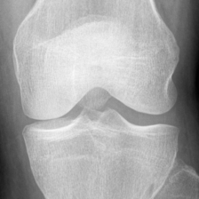
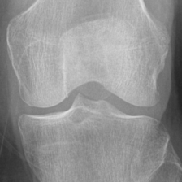
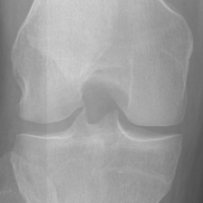
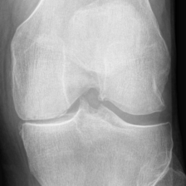
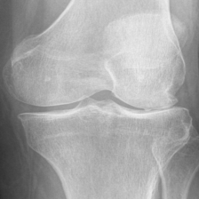
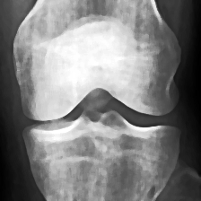
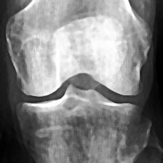
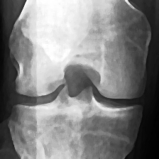
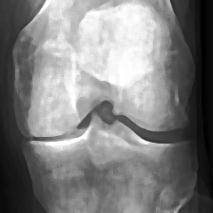
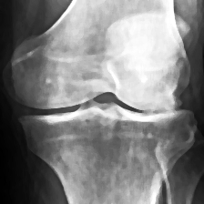
Grade0 Grade1 Grade2 Grade3 Garde4
Normal X-rays Images
Preprocessed X-ray Images

Slide 8
Data Preparation:
Augmented Dataset:
 | GRADE 0 | GRADE 1 | GRADE 2 | GRADE 3 | GRADE 4
TEST | 658 | 816 | 760 | 860 | 923
TRAIN | 1600 | 1600 | 1600 | 1600 | 1600
EVALUATION | 400 | 400 | 400 | 400 | 400
TOTAL | 2658 | 2816 | 2760 | 2860 | 2923
• 14017 augmented images of dimensions 224x224.

Slide 9
Literature
Sl. # | Title of the paper | Source | Inferences
1 | Knee osteoarthritis severity prediction using an attentive multi-scale deep convolutional neural network [3] | Multimedia Tools and Applications | The study combines HRNet and attention mechanisms to enhance knee osteoarthritis prediction, offering greater accuracy and efficiency than remaining methods.
2 | Fully automatic knee osteoarthritis severity grading using deep neural networks with a novel ordinal loss [4] | Computerized Medical Imaging and Graphics | This paper presents a two-stage deep learning approach that integrates a YOLOv2-based knee joint detection with a fine-tuned CNN using a novel ordinal loss function to automatically classify knee osteoarthritis severity, achieving state-of-the-art performance.
3 | Classification and Risk Estimation of Osteoarthritis Using Deep Learning Methods [5] | Measurement Sensors | The study provides a promising approach for automated OA classification and risk estimation, with potential for further refinement in clinical applications.

Slide 10
Literature
Sl. # | Title of the paper | Source | Inferences
4 | Automatic Detection of Knee Osteoarthritis Disease with the Developed CNN, NCA and SVM Based Hybrid Model [6] | Traitement du Signal | The study proposes an automated deep learning-based ordinal classification approach for early diagnosis and grading of knee osteoarthritis using X-ray images.
5 | KOA-CCTNet: An Enhanced Knee Osteoarthritis Grade Assessment Framework Using Modified Compact Convolutional Transformer Model [7] | IEEE Access | The KOA-CCTNet model, based on a modified compact convolutional transformer, showed superior performance over other models in accurately grading knee osteoarthritis from X-ray images.
6 | Stratifying knee osteoarthritis features through multitask deep hybrid learning: Data from the osteoarthritis initiative[8] | Computer Methods and Programs in Biomedicine, Volume 242, September 2023, Article 107807. | Replaced the fully connected layers in CNNs with Global Average Pooling (GAP) layers for feature extraction, to reduce the number of parameters.
Notes:
The ensemble model achieved 98% accuracy and a 0.99 Quadratic Weighted Kappa score for classifying knee osteoarthritis severity from X-ray images.

Slide 11
Literature :
Sl. # | Title of the paper | Source | Inferences
7 | Learning From Highly Confident Samples for Automatic Knee Osteoarthritis Severity Assessment: Data From the Osteoarthritis Initiative[9] | IEEE Journal of Biomedical and Health Informaticsvol. 26, no. 3, pp. 1239-1250 | The paper proposes a deep learning method for knee osteoarthritis (OA) severity assessment, using high-confidence samples and a hybrid loss function to enhance accuracy, excelling in both severity grading and early detection.
8 | Evaluating the efficacy of deep learning models for knee osteoarthritis prediction based on Kellgren-Lawrence grading system .[10] | Elsevier e-Prime - Advances in Electrical Engineering, Electronics and Energy, vol. 5, p. 100266 | The study emphasizes the need for accurate, reliable models to automate KOA classification, reducing dependence on radiologists in underserved areas. Increasing dataset size and fine-tuning models could further enhance their clinical effectiveness, improving decision-making.

Slide 12
Literature :
Sl. # | Title of the paper | Source | Inferences
9 | A Sequential VGG16+CNN-Based Automated Approach With Adaptive Input for Efficient Detection of Knee Osteoarthritis Stages[11] | IEEE Access, Vol. 12, 2024, pp. 62407-62415 | By combining the feature extraction power of VGG16 and the spatial analysis capabilities of CNN, the hybrid model significantly improves the accuracy of OA detection from X-ray images
10 | Machine Learning-Based Automatic Classification of Knee Osteoarthritis Severity Using Gait Data and Radiographic Image[12] | IEEE Access, Vol. 8, 2020, pp. 120597-120603 | The integration of both gait data and radiographic images significantly outperforms the use of radiographic images alone for KOA classification in the deep learning model Inception-ResNet-v2.

Slide 13
VGG16:
Layers: VGG16 has 16 weight layers:
1.13 convolutional layers
2. 3 fully connected layers
3. Max-pooling layers after some of the convolutional layers.
VGG16 is commonly used as a pretrained model, meaning it can be fine-tuned for specific tasks such as object detection and image classification.

Slide 14
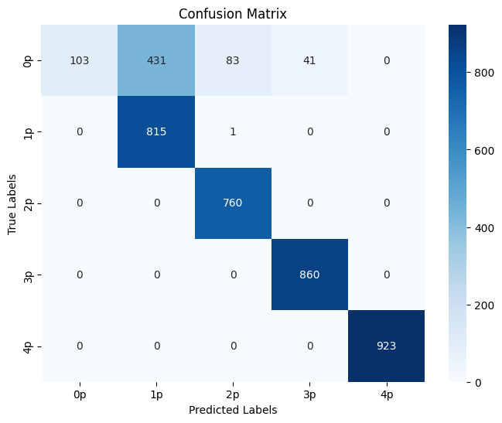
VGG16:
Confusion matrix images :

Slide 15
EfficientNetV2B0
EfficientNet, introduced by Google AI researchers in 2019, excels in tasks like object detection and image segmentation.
It employs compound scaling to optimize model dimensions—width, depth, and resolution.
The architecture achieves efficiency without compromising accuracy, overcoming traditional accuracy-resource trade-offs.
The EfficientNetV2B0 architecture consists of 9 layers in total. These layers include, Conv2D Layers, Global Average Pooling Layer.

Slide 16
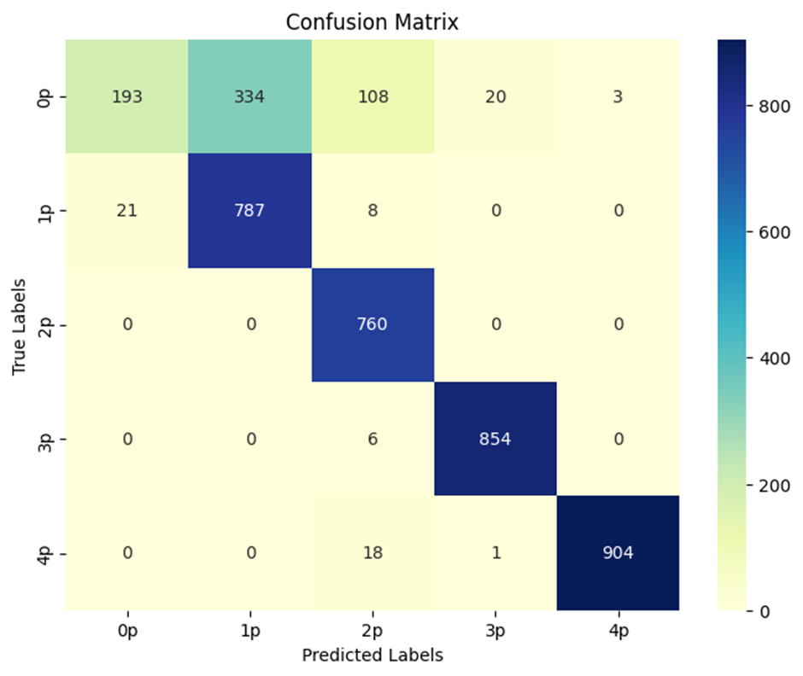
EfficientNetV2B0:

Slide 17
RESNET50:
ResNet-50 was developed by Microsoft Research Asia and released in 2015.
50 layers in total, consisting of:
1 Conv layer (7x7 convolution)
1 Max-pooling layer
16 Residual blocks (each consisting of 3 convolutional layers)
Fully connected (FC) layer
ResNet-50 is a convolutional neural network (CNN) that excels at image classification.
Feature Hierarchy in ResNet50 are Low-level features and High-level features.

Slide 18
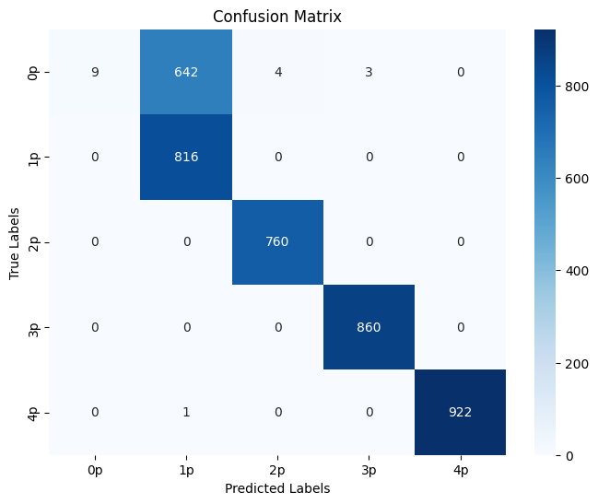
RESNET50:

Slide 19
Results:
Model | Accuracy | Precision | Recall | F1- score
VGG- 16 | 0.8616 | 0.9012 | 0.8616 | 0.8231
ResNet50 | 0.8382 | 0.9087 | 0.8382 | 0.7822
EfficientNetB2V0 | 0.8708 | 0.8881 | 0.8708 | 0.8486

Slide 20
Methodology:
Dataset
Total 10000 images
2000 (Grade 0 ) Images
Train 8000 images
Validation 2000 images
PREPROCESSING
2000 (Grade 1 ) Images
Quantum Noise Reduction
ResNet
Grad CAM
Augmentation
2000 (Grade 2 ) Images
Feature Extraction
Histogram Equalization
2000 (Grade 3 ) Images
Convolutional Block Attention Module(CBAM)
2000 (Grade 4 ) Images
Unsharp Masking
SVM
Machine learning
classifier
Test Dataset
(To be given after
Training model)
Output Prediction
05-11-2024
Review 1.3
20

Slide 21
ResNet:
ResNet uses residual connections that allow gradients to flow directly through the network layers, effectively mitigating the vanishing gradient problem and enabling the training of much deeper neural networks.
CBAM:
Channel Attention assigns importance scores to each feature channel by using global average and max pooling, followed by fully connected layers, to amplify informative channels.
Spatial Attention highlights key regions within feature maps by pooling across channels, concatenating results, and passing them through a convolutional layer, creating a spatial attention map.
Channel and spatial attention weights are applied to the original feature map, enhancing focus on critical channels and spatial areas.
This sequential application of Channel and Spatial Attention helps the model filter out irrelevant information, improving classification accuracy.

Slide 22
SVM:
SVMs excel with limited data, making them ideal for medical imaging where data collection and labeling can be challenging.
SVMs handle high-dimensional data effectively, leveraging features extracted from networks like ResNet + CBAM for optimal classification.
SVMs create decision boundaries that maximize class separation, improving classification accuracy for features that are more linearly separable.

Slide 23
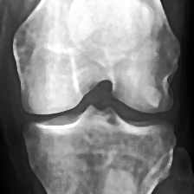
Model Block Diagram:
ResNet Convolutional Layers
Residual Block + CBAM
Residual Block + CBAM
Input Image
(Additional Residual Blocks with CBAM)
Global Average Pooling
Predicted Class 0
SVM Classifier
Feature Vector Output

Slide 24
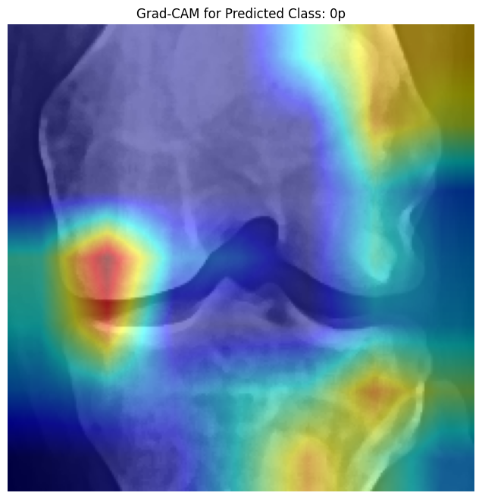
Results for Proposed Model:
Accuracy | 0.6014
Precision | 0.6589
Recall | 0.6014
Recall | 0.4575

Slide 25
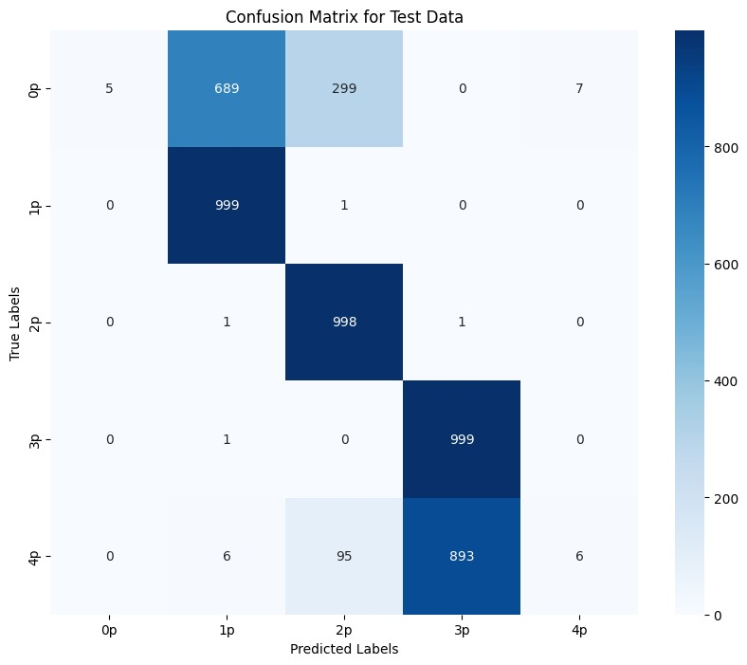
Confusion Matrix:

Slide 26
Timeline:
Review | Month | Milestone
1.1 | Aug 2024 | Data preparation, Data Preprocessing, Literature survey
1.2 | Sep 2024 | Literature survey, Analysis of state-of-the-art models
1.3 | Nov 2024 | Building of classification model
2.1 | Jan 2025 | Validation and performance comparison, Paper draft
2.2 | Mar 2025 | Paper Draft
2.3 | May 2025 (External Review) | Project Report / Dissertation

Slide 27
Deliverables:
Developed a Deep learning model of ResNet+CBAM and svm as classifier for classification of Knee Osteoarthritis.

Slide 28
References:
A. Mobasheri, C. S. Thudium, A.-C. Bay-Jensen, T. Maleitzke, S. Geissler, G. N. Duda, and T. Winkler, "Biomarkers for osteoarthritis: Current status and future prospects," Best Practice & Research Clinical Rheumatology, vol. 37, p. 101852, June 2023.
Chen, Pingjun (2018), “Knee Osteoarthritis Severity Grading Dataset”, Mendeley Data, V1. [Online]. Available: https://tinyurl.com/4h7pwaaa. [Accessed Sept. 12, 2024].
R. K. Jain, P. K. Sharma, S. Gaj, A. Sur, and P. Ghosh, "Knee osteoarthritis severity prediction using an attentive multi-scale deep convolutional neural network," Multimedia Tools and Applications, vol. 83, pp. 6925–6942, June 2023.
P. Chen, L. Gao, X. Shi, K. Allen, and L. Yang, "Fully automatic knee osteoarthritis severity grading using deep neural networks with a novel ordinal loss," Computerized Medical Imaging and Graphics, vol. 75, pp. 84-92, June 2019.
A. R. Patil and S. Salunkhe, "Classification and Risk Estimation of Osteoarthritis Using Deep Learning Methods," Measurement: Sensors, vol. 24, pp. 101279, Oct. 2024.
S. Aslan, "Automatic Detection of Knee Osteoarthritis Disease with the Developed CNN, NCA and SVM Based Hybrid Model," in Traitement du Signal, vol. 40, no. 1, pp. 317-326, Feb. 2023.

Slide 29
References:
M. Jahan, M. Z. Hasan, I. J. Samia, K. Fatema, M. A. H. Rony, M. S. Arefin, and A. Moustafa, "KOA-CCTNet: An Enhanced Knee Osteoarthritis Grade Assessment Framework Using Modified Compact Convolutional Transformer Model," IEEE Access, vol. 12, pp. 107719-107738, July 2024.
Y. X. Teoh, A. Othmani, K. W. Lai, and S. L. Goh, "Stratifying knee osteoarthritis features through multitask deep hybrid learning: Data from the osteoarthritis initiative," Computer Methods and Programs in Biomedicine, vol. 242, p. 107807, Sep. 2023.
Y. Wang, Z. Bi, Y. Xie, T. Wu, X. Zeng, S. Chen, and D. Zhou, "Learning From Highly Confident Samples for Automatic Knee Osteoarthritis Severity Assessment: Data From the Osteoarthritis Initiative," IEEE Journal of Biomedical and Health Informatics, vol. 26, no. 3, pp. 1239-1250, Mar. 2022.
V. K. Vijaya, V. Kalpana, and G. H. Kumar, "Evaluating the efficacy of deep learning models for knee osteoarthritis prediction based on Kellgren-Lawrence grading system," e-Prime - Advances in Electrical Engineering, Electronics and Energy, vol. 5, p. 100266, Aug. 2023.
S. U. Rehman and V. Gruhn, "A Sequential VGG16+CNN-Based Automated Approach With Adaptive Input for Efficient Detection of Knee Osteoarthritis Stages," IEEE Access, vol. 12, pp. 62407-62415, Apr. 2024
S. B. Kwon, H.-S. Han, M. C. Lee, H. C. Kim, Y. Ku, and D. H. Ro, "Machine Learning-Based Automatic Classification of Knee Osteoarthritis Severity Using Gait Data and Radiographic Images," IEEE Access, vol. 8, pp. 120597-120603, July 2020.

Slide 30
Thank You

